Slide 1
CHAPTER 4: JavaScript – Part1
CLO3: Create interactive web pages using current standards-compliant client-side web technologies

Slide 2
LECTURE OUTLINE
Introduction to JavaScript
CLIENT-SIDE PROGRAMMING FOR DYNAMIC WEB CONTENTS
Key Terms
YOUR FIRST JAVASCRIPT PROGRAM
INPUTS AND OUTPUTS
MEMORY CONCEPTS
ARITHMETIC OPERATORS
CONTROL STATEMENTS
SELECTION STATEMENTS

Slide 3
OBJECTIVES
Write simple JavaScript programs
Use input and output statements
Learn basic memory concepts
Use arithmetic operators and their precedence
Learn basic problem solving techniques
Use the if and if…else, selection statements to choose among alternative actions
Use the while repetition statement to execute statements repeatedly
Implement counter-controlled repetition statements and sentinel-controlled repetition
Use the increment, decrement and assignment operators
Learn essentials of counter controlled repetition
Use the for and do…while repetition statements to execute statements in a program repeatedly
Perform multiple selection using the switch selection statement
Use the break and continue program control statements
Use the logical or operators to make decisions
Use Arrays

Slide 4
INTRODUCTION to JavaScript
JavaScript often abbreviated as JS, is a high-level, interpreted programming language.
It is a language which is also characterized as dynamic, weakly typed, prototype-based and multi-paradigm.
Alongside HTML and CSS, JavaScript is one of the three core technologies of the World Wide Web.
JavaScript enables interactive web pages and thus is an essential part of web applications.
The vast majority of websites use it, and all major web browsers have a dedicated JavaScript engine to execute it.
JavaScript supports much of the structured programming syntax from C.

Slide 5
INTRODUCTION to JavaScript
JavaScript enhances the functionality and appearance of web pages
It is a dynamically typed language and offers:
Primary data types: Strings, Numbers, Booleans,……….
Control structures: Conditions and loops
Functions
Pre-defined objects: e.g. Array, Date, Math, window, document as well as objects from the DOM(Document Object Model)
The use of “pure” JavaScript only is quite rare today
Instead make use of:
Powerful libraries and frameworks: jQuery, React.js, AngularJS etc.
Many of the programming concepts found in this lecture has been covered during Fundamentals of programming

Slide 6
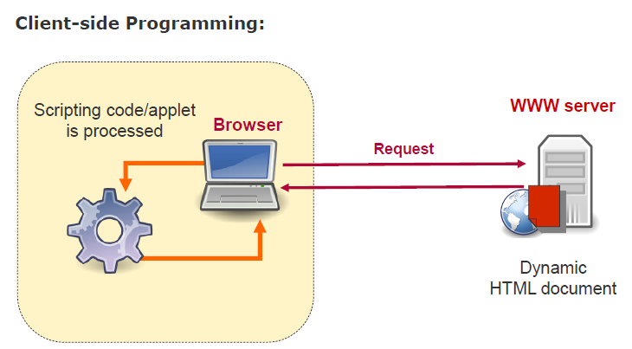
Client-side programming for Dynamic Web Contents
JavaScript enables Dynamic Web Documents Generated on Client-Side

Slide 7
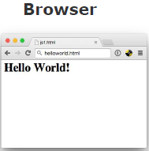
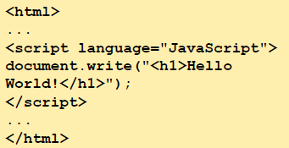
JavaScript / ECMAScript (1/2)
HTML document
JavaScript was originally introduced by Netscape
Later standardized as ECMAScript
Classical application: client-side scripting
Allows access to the document contents (DOM)
Allows responses to the user’s actions (EventHandler)
*Note: Javascript has NO connection to the Java Programming Language except for the name

Slide 8
Creating your first JAVASCRIPT program
Create a folder in your desktop called "CIA-2503"
Create a web page “Exercise1.html"
Edit your page with Notepad++ or VS code
Type the next page code content
JavaScript is client side programming language so, test your page directly in the browser (double click on your page or open it with your browser)

Slide 9
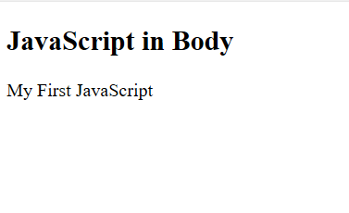
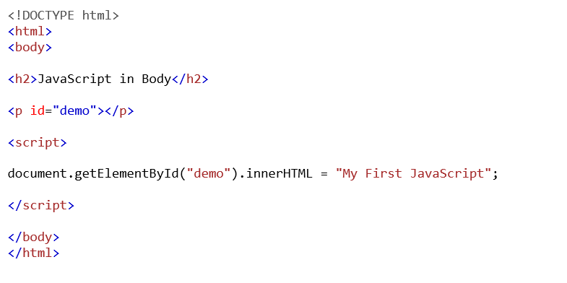
My First JavaScript Page
Script tags <script></script> are used to hold JavaScript. See Exercise1.html below:

Slide 10
INPUT and OUTPUT - JavaScript Display Possibilities
JavaScript can “display” data in different ways:
Writing into an HTML element, using innerHTML.
Writing into an HTML output using document.write()
Writing into an alert box, using window.alert().

Slide 11
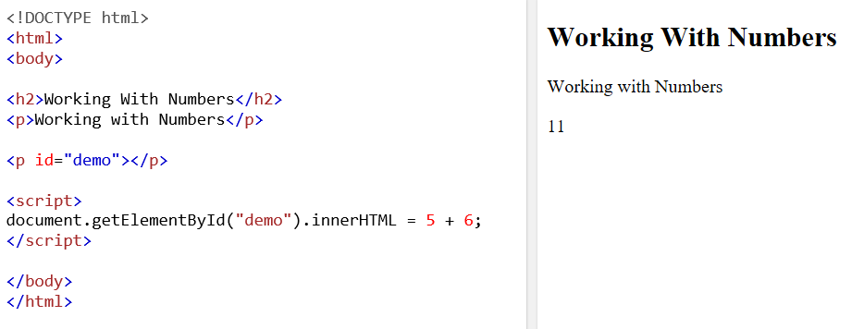
INPUT and OUTPUT - JavaScript Display Possibilities
Writing into an HTML element, using innerHTML
To access an HTML element, JavaScript can use Document.getElementById(id) method.
The id attribute defines the HTML element. The innerHTML property defines the HTML content to be presented.

Slide 12
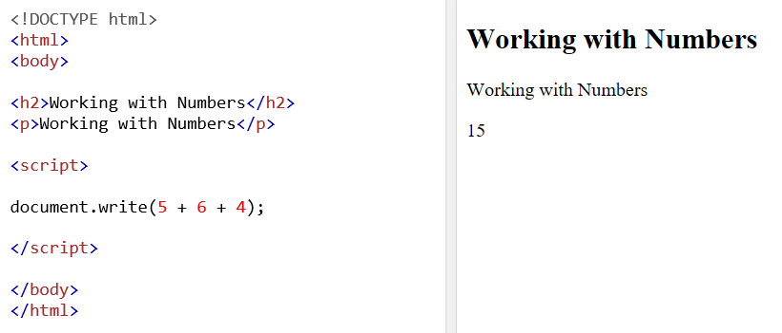
INPUT and OUTPUT - JavaScript Display Possibilities
Writing into an HTML output using document.write() which is mostly used for testing purposes

Slide 13
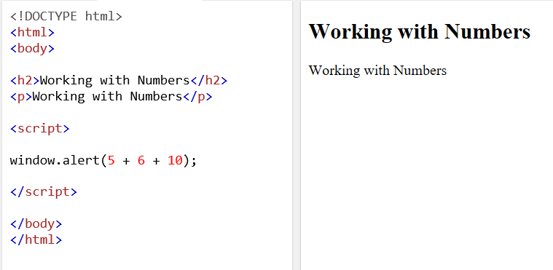
INPUT and OUTPUT -JavaScript Display Possibilities
Writing into an alert box, using window.alert()

Slide 14
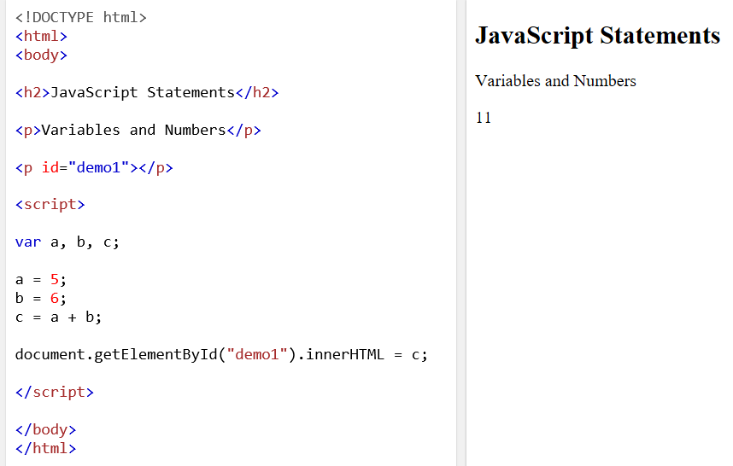
INPUT and OUTPUT - Statements, Variables and Numbers
Create “Excercise2.html” and type the following code

Slide 15
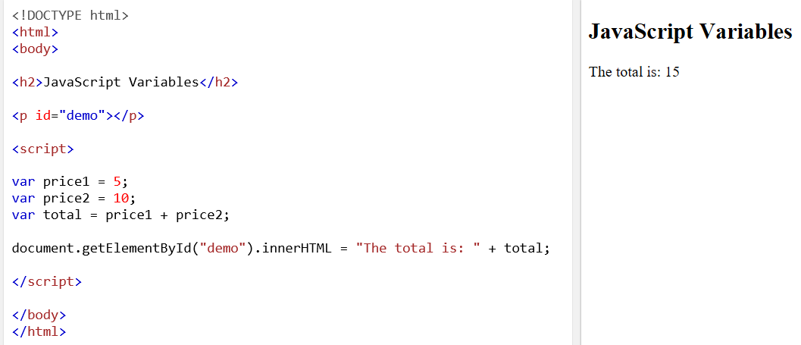
INPUT and OUTPUT - Statements, Variables and Numbers contd.
Create “excercise2b.html” and type the following code

Slide 16
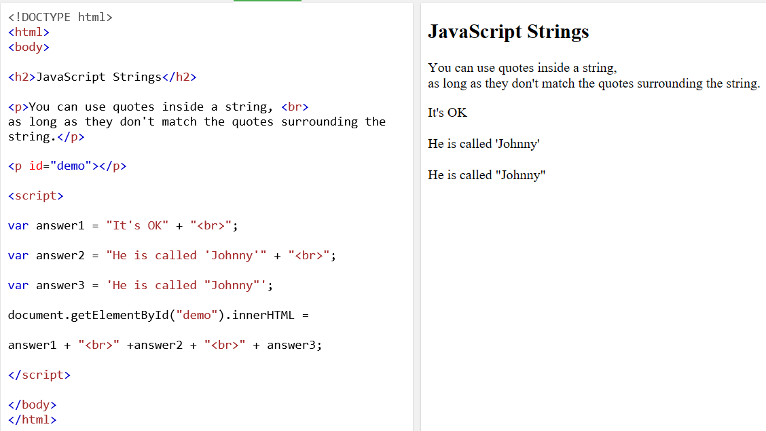
Working with Strings
Strings are surrounded by single or double quotes
Create “excercise3.html” and type the following code

Slide 17
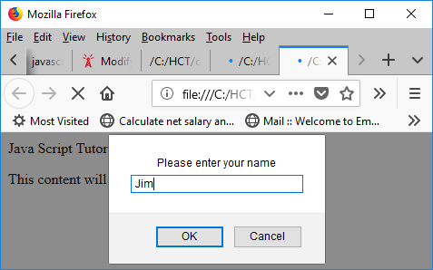
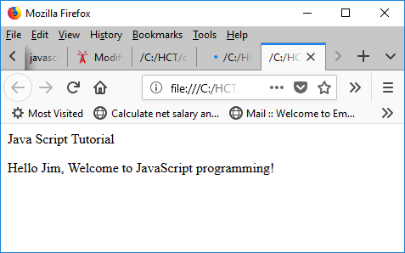
INPUT and OUTPUT - Reading String InputS
The next script creates a dynamic welcome page that obtains the user’s name, then displays it on the page.
The script uses another predefined dialog box from the window object—a prompt dialog—which allows the user to enter a value that the script can use.

Slide 18
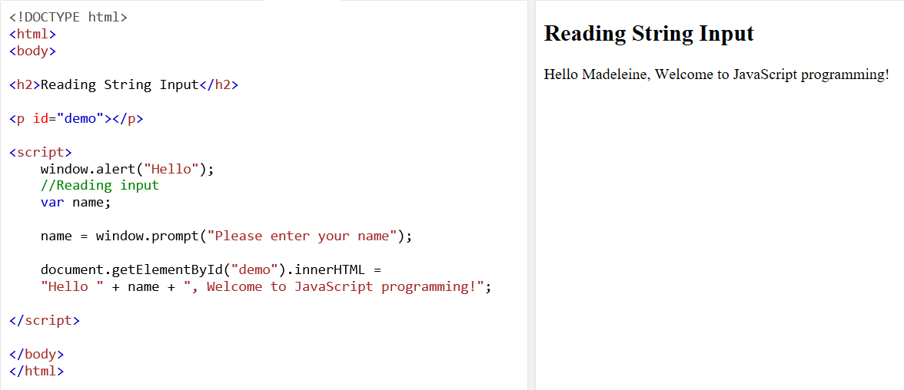
INPUT and OUTPUT - Reading String Input
Create a web page “exercise4.html", type the following code, and test it in the browser

Slide 19
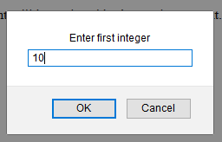
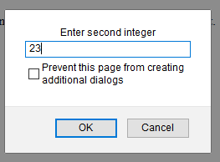
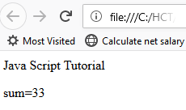
INPUT and OUTPUT - Reading numbers: Integers
Our next script illustrates another use of prompt dialogs to obtain input from the user.
These figures inputs two integers typed by a user at the keyboard, computes the sum of the values and displays the result

Slide 20
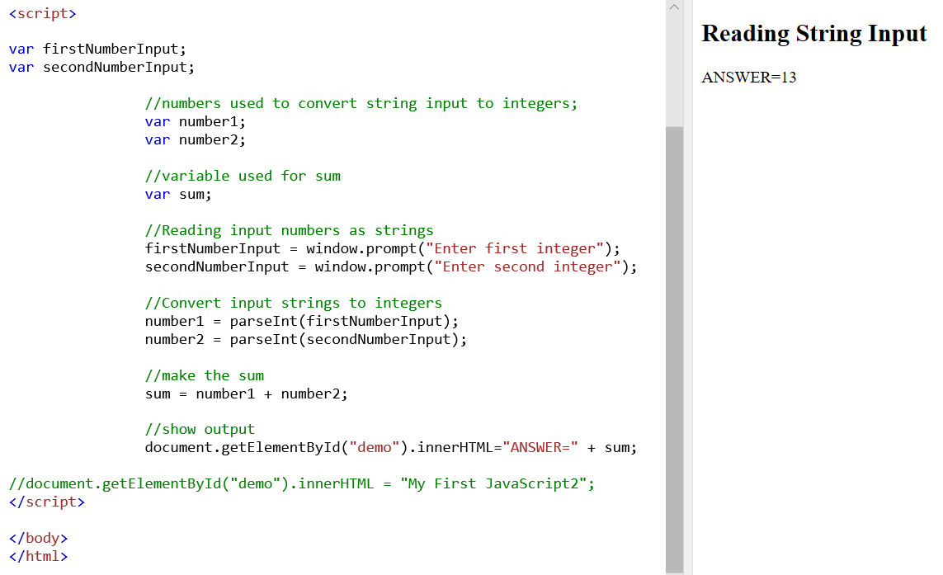
INPUT and OUTPUT - Reading numbers: Integers
Create a new web page “excercise5.html”
You will enter the String values at runtime using window prompts

Slide 21
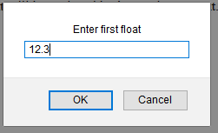
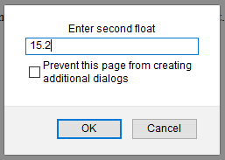
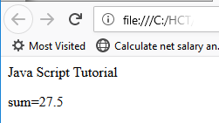
INPUT and OUTPUT - Reading numbers: floats
Our next script illustrates another use of prompt dialogs to obtain input from the user.
These program inputs two floats typed by a user at the keyboard, computes the sum of the values and displays the result

Slide 22
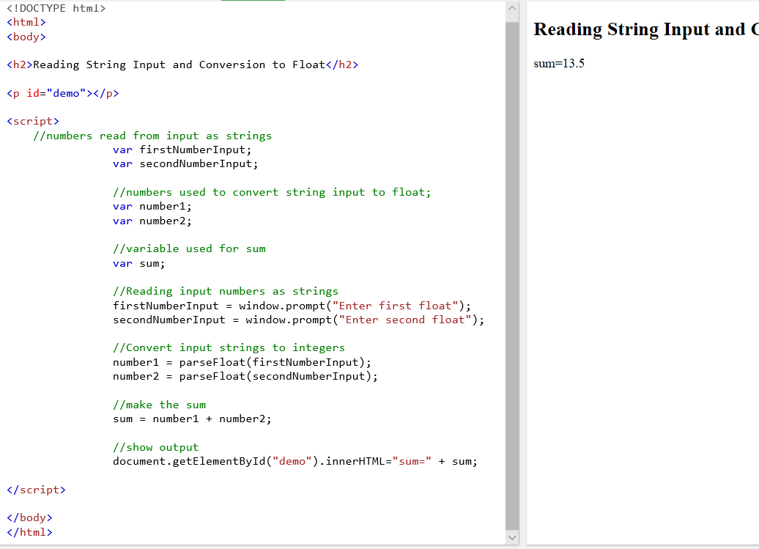
INPUT and OUTPUT - Reading numbers: floats
Create a web page "exercise6.html", type the following code, and test it in the browser

Slide 23
Memory Concepts…
Variable names correspond to locations in the computer’s memory
Every variable has a name, a type and a value
When a value is placed in a memory location, the value replaces the previous value in that location
When a value is read out of a memory location, the process is nondestructive

Slide 24
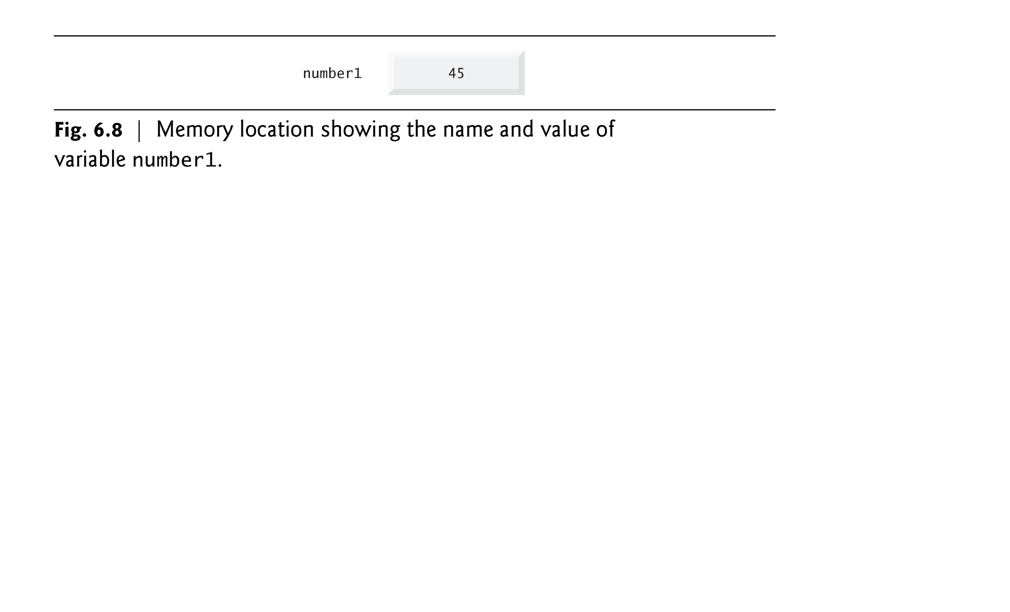
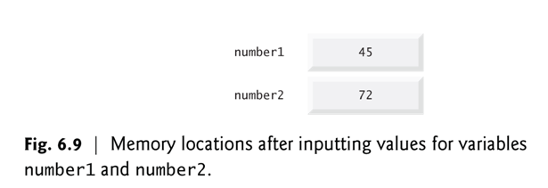
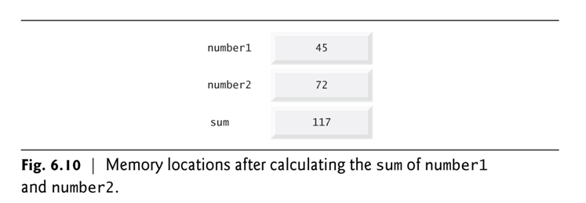

Slide 25
Memory Concepts
JavaScript does not require variables to have a datatype before they can be used in a script
A variable in JavaScript can contain a value of any data type, and in many situations, JavaScript automatically converts between values of different types for you
JavaScript is referred to as a loosely typed language
When a variable is declared in JavaScript, but is not given a value, it has an undefined value
Attempting to use the value of such a variable is normally a logic error.
When variables are declared, they are not assigned default values, unless specified otherwise by the programmer
To indicate that a variable does not contain a value, you can assign the value null to it.

Slide 26
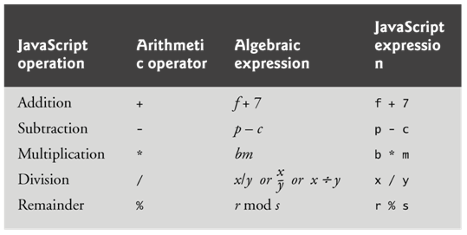
Arithmetic Operators
The basic arithmetic operators (+, -, *, /, and %) are binary operators, because they each operate on two operands
JavaScript provides the remainder operator, %, which yields the remainder after division
Arithmetic expressions in JavaScript must be written in straight-line form to facilitate entering programs into the computer

Slide 27
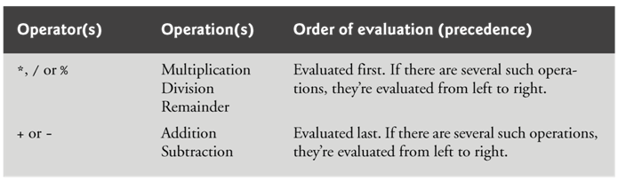
Arithmetic Operators
Parentheses can be used to group expressions as in algebra.
Operators in arithmetic expressions are applied in a precise sequence determined by the rules of operator precedence:

Slide 28
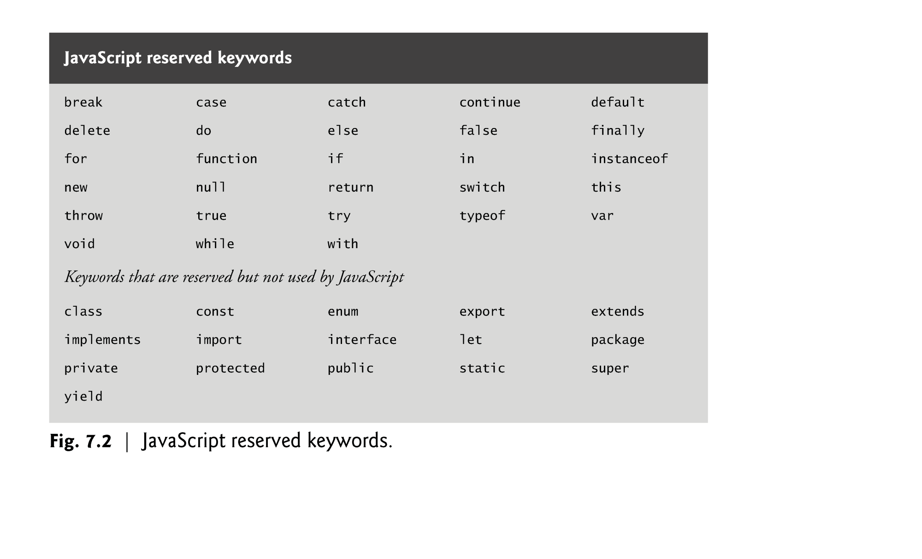
In addition to keywords, JavaScript has other words that are reserved for use by the language, such as the values null, true and false, and words that are reserved for possible future use.

Slide 29
Control Statements - Selection Structures
JavaScript provides 3 selection structures
The if statement either performs (selects) an action if a condition is true or skips the action if the condition is false.
Called a single-selection statement because it selects or ignores a single action or group of actions.
The if…else statement performs an action if a condition is true and performs a different action if the condition is false.
Double-selection statement because it selects between two different actions or group of actions.
The switch statement performs one of many different actions, depending on the value of an expression.
Multiple-selection statement because it selects among many different actions or groups of actions.
JavaScript provides 4 repetition statements, namely, while, do…while, for and for…in.

Slide 30
Control Statements – JavaScript OnLoad Event
In this JavaScript Lecture, the new codes presented will be added inside of a function which will be called from the onload() Event in the <body> element of the html page.
Functions will be fully covered in the next lecture for Javascript
The onload event occurs when an object has been loaded and is mostly used within the <body> element to execute a script once a web page has completely loaded all content (including images, script files, CSS files, etc.)
The onload event can be used to check the visitor's browser type and browser version, and load the proper version of the web page based on the information.

Slide 31
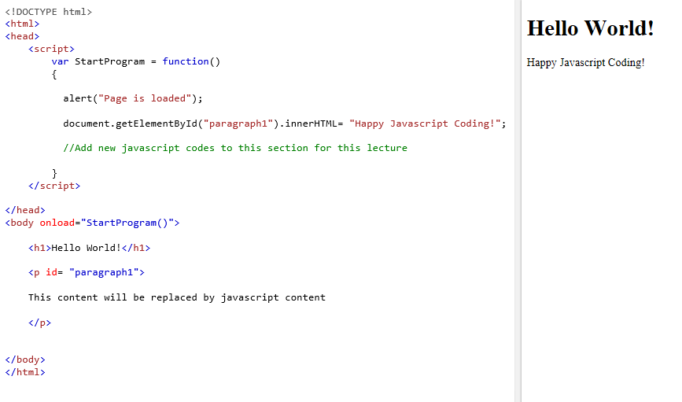
Javascript - OnLoad Event
During this lecture we will use this code format to start the program as soon as the body of the html page loads.
New JavaScript codes will be added to the StartProgram Function.

Slide 32
Selection Statements
If…if…else
Switch…

Slide 33
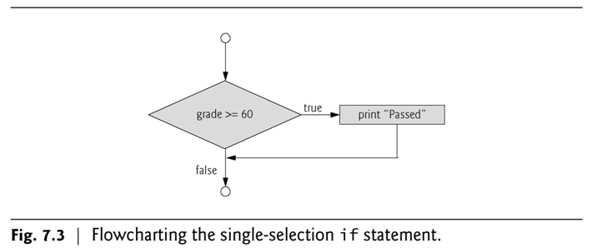
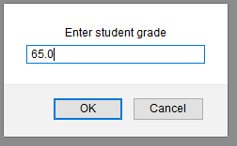
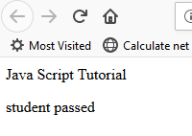
if - Selection Statement
Allows you to make a decision based on a condition.

Slide 34
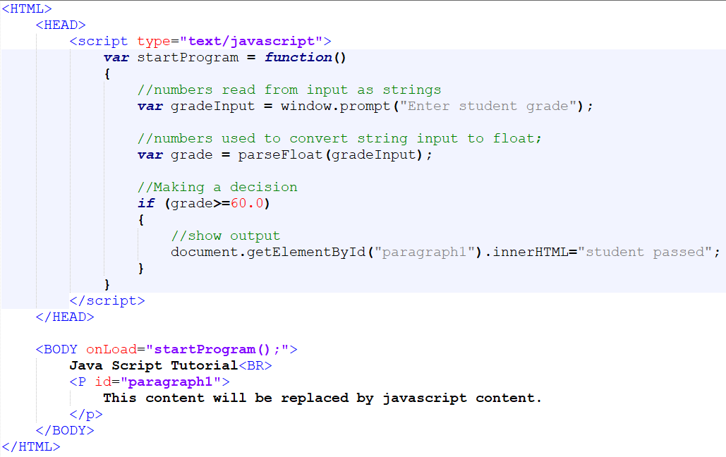
if Selection Statement
Create a web page "exercise7.html“.
Type the following code, and test it in the browser

Slide 35
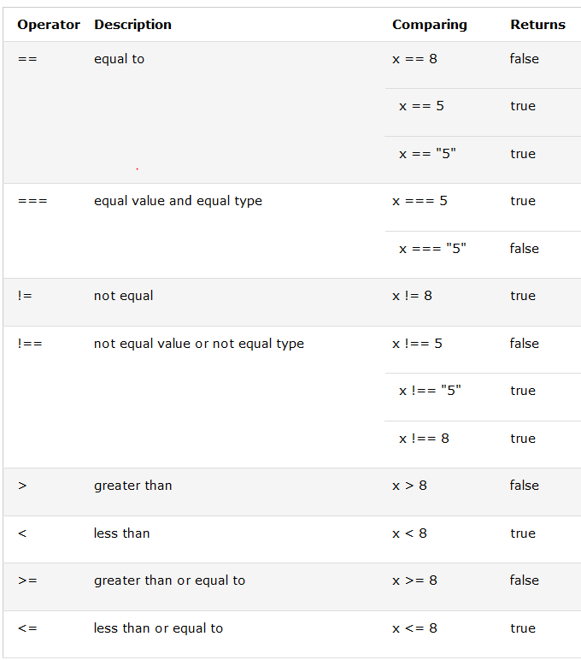
JavaScript - comparison and logical operators used in conditions.

Slide 36
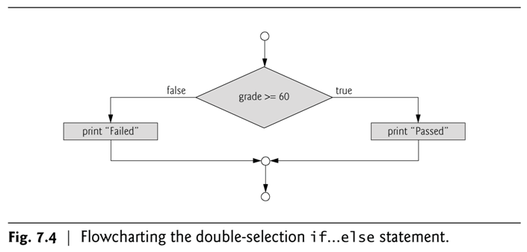
if...else Selection Statement…
Allows you to specify that different actions should be performed when the condition is TRUE and/or when the condition is FALSE.

Slide 37
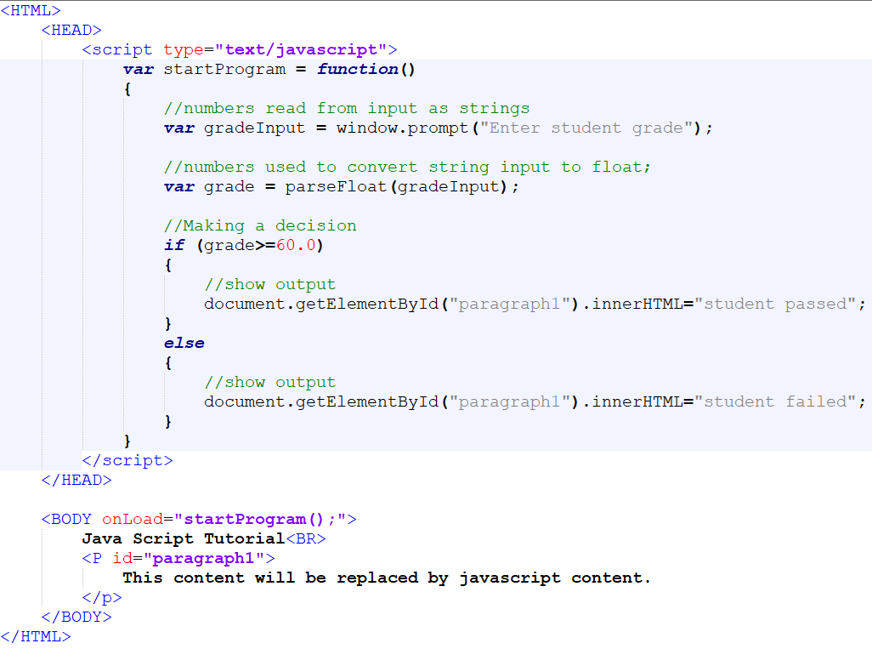
if...else Selection Statement…
Create a web page "exercise8.html“.
Type the following code, and test it in the browser

Slide 38
nested if...else Selection Statement
Nested if…else statements
Test for multiple cases by placing if…else statements inside other if…else statements
The JavaScript interpreter always associates an else with the previous if, unless told to do otherwise by the placement of braces ({})
The if selection statement expects only one statement in its body
To include several statements, enclose the statements in braces ({ and })
A set of statements contained within a pair of braces is called a block

Slide 39
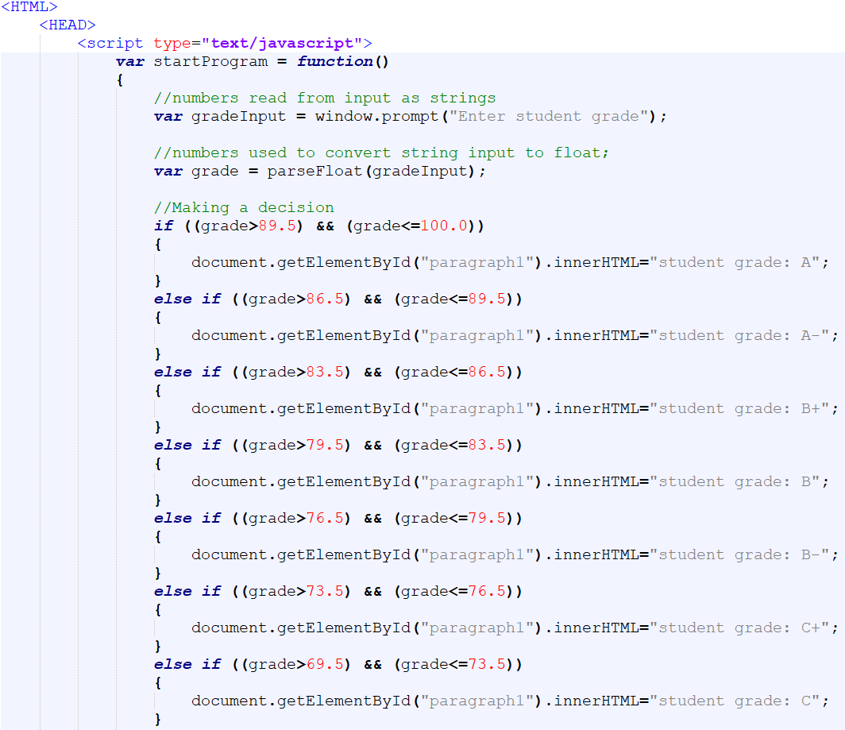
nested if...else Selection Statement
Create a web page "exercise9.html“.
Code continues onto next slide

Slide 40
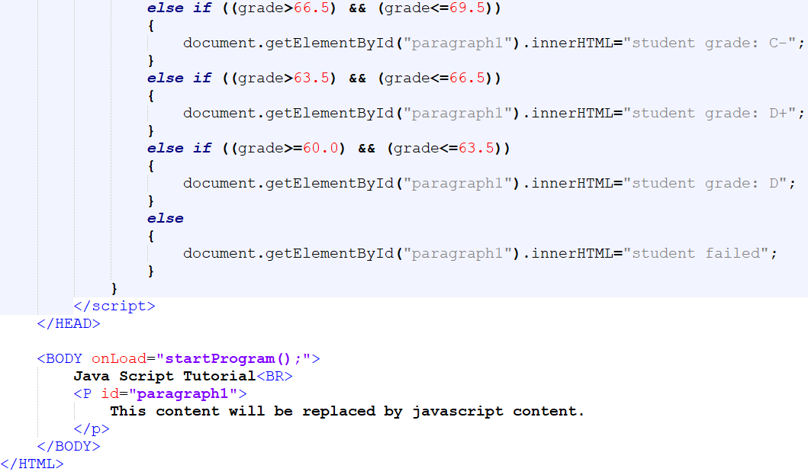
nested if...else Selection Statement
Code continues on from previous slide

Slide 41
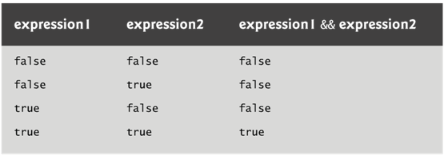
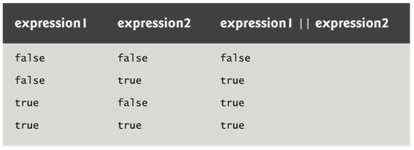
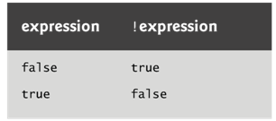
Logical Operators
Logical operators can be used to form complex conditions by combining simple conditions
&& (logical AND)
|| (logical OR)
! (logical NOT, also called logical negation)

Slide 42
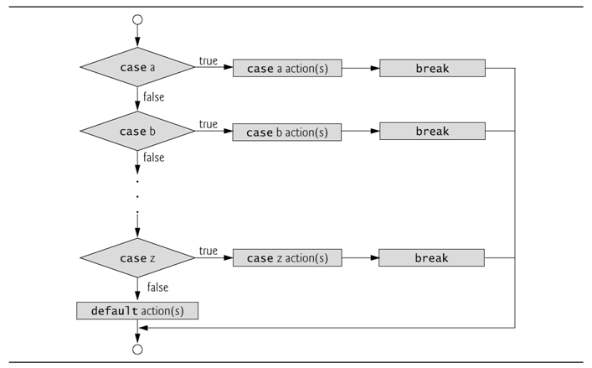
Switch Multiple-Selection Statement
switch multiple-selection statement
Tests a variable or expression separately for each of the values it may assume
Different actions are taken for each value

Slide 43
Switch Multiple-Selection Statement…
switch statement
Consists of a series of case labels and an optional default case
When control reaches a switch statement
The script evaluates the controlling expression in the parentheses
Compares this value with the value in each of the case labels
If the comparison evaluates to true, the statements after the case label are executed in order until a break statement is reached
The break statement is used as the last statement in each case to exit the switch statement immediately
The default case allows you to specify a set of statements to execute if no other case is satisfied
Usually the last case in the switch statement

Slide 44
Switch Multiple-Selection Statement…
Each case can have multiple actions (statements)
Braces are not required around multiple actions in a case of a switch
The break statement is not required for the last case because program control automatically continues with the next statement after the switch

Slide 45
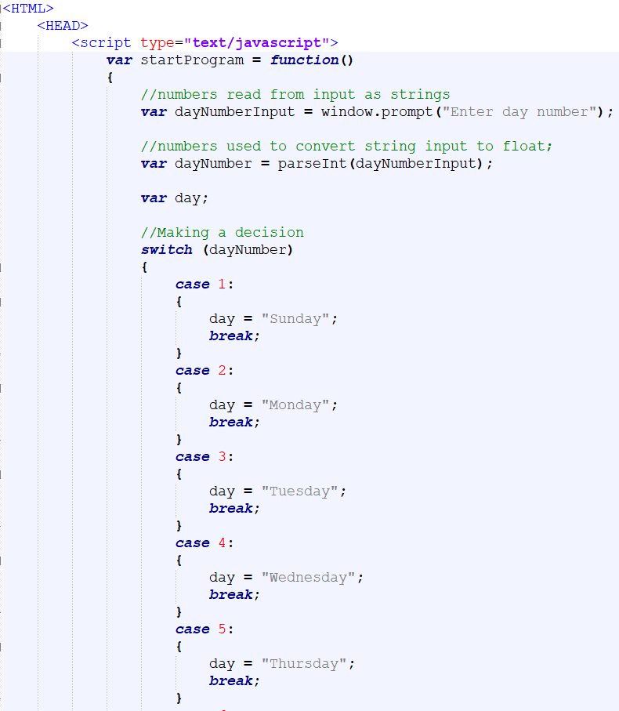
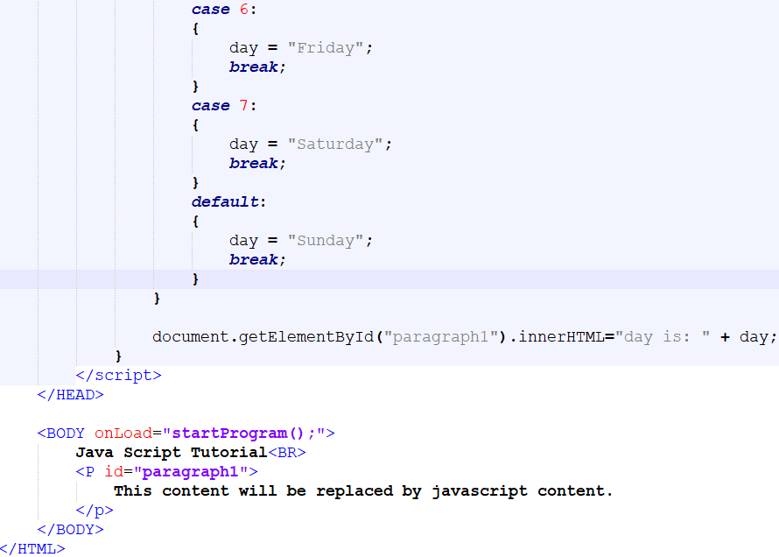
Switch Multiple-Selection Statement…
Create a web page "exercise10.html“.
This example uses the weekday number to present the weekday name:

Slide 46
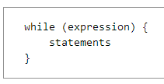
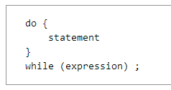
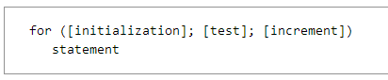
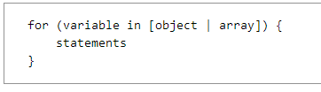
Repetition Statements

Slide 47
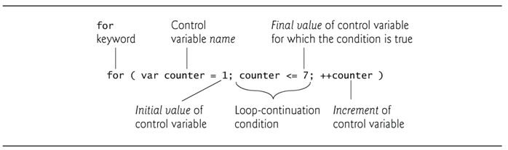
for Repetition Statement…
for statement
Specifies each of the items needed for counter-controlled repetition with a control variable
Can use a block to put multiple statements into the body
Allows you to specify that an action is to be repeated for a number of times.
for statement header contains 3 expressions

Slide 48
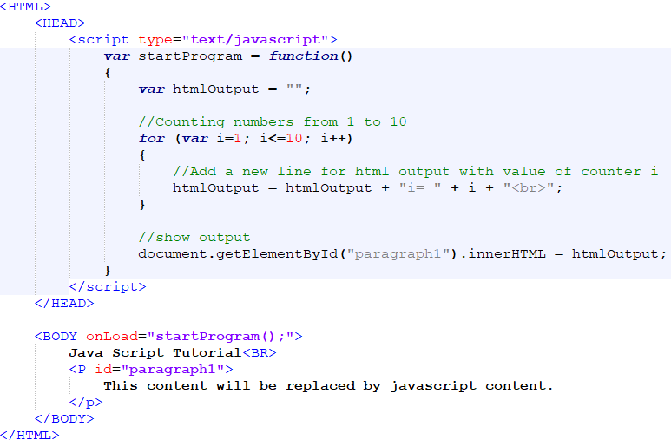

for Repetition Statement…
Create a web page "exercise11.html“.
This example counts numbers from 1 to 10

Slide 49





for Repetition Statement…
Create a web page "exercise12.html“.
This example calculates student average of 3 grades entered by user input.

Slide 50


for Repetition Statement…
Create a web page "exercise13.html“.
Type the following code, and test it in the browser.
This example allows to sum the even integers from 2 to 100.

Slide 51
Essentials of Counter-Controlled Repetition…
Counter-controlled repetition requires
name of a control variable
initial value of the control variable
the increment (or decrement) by which the control variable is modified each time through the loop
the condition that tests for the final value of the control variable to determine whether looping should continue
The double-quote character delimits the beginning and end of a string literal in JavaScript
it cannot be used in a string unless it is preceded by a \ to create the escape sequence \”
HTML5 allows either single quotes (') or double quotes (") to be placed around the value specified for an attribute
JavaScript allows single quotes to be placed in a string literal

Slide 52

while Repetition Statement
while
Allows you to specify that an action should be repeated while some condition remains true
The body of a loop may be a single statement or a block
Eventually, the condition becomes false and repetition terminates
var product=2;
while (product<=1000)
product=product*2;

Slide 53


while Repetition Statement
Create a web page "exercise14.html“.
This example counts numbers from 1 to 10 using while repetition statement.

Slide 54

while Repetition Statement
Create a web page "exercise15.html“.
This example calculates the student average of 3 entered grades

Slide 55
Example 3…
Problem Statement
Develop a student-averaging script that will process an arbitrary number of grades each time the script is run
Sentinel-controlled repetition
Special value called a sentinel value (also called a signal value, a dummy value or a flag value) indicating the end of data entry
Often is called indefinite repetition, because the number of repetitions is not known in advance
Choose a sentinel value that cannot be confused with an acceptable input value

Slide 56

while Repetition Statement – With Sentinel Values
Create a web page "exercise16.html“.
Type the following code, and test it in the browser.

Slide 57






while Repetition Statement
Code contd. from previous slide

Slide 58

Assignment Operators
JavaScript provides the arithmetic assignment operators +=, -=, *=, /= and %=, which abbreviate certain common types of expressions.

Slide 59

Increment and Decrement Operators
When incrementing or decrementing a variable in a statement by itself, the pre-increment and post-increment forms have the same effect, and the pre-decrement and post-decrement forms have the same effect
When a variable appears in the context of a larger expression, pre-incrementing the variable and post-incrementing the variable have different effects. Pre-decrementing and post-decrementing behave similarly.

Slide 60

Increment and Decrement Operators
The increment operator, ++, and the decrement operator, --, increment or decrement a variable by 1, respectively.
If the operator is prefixed to the variable, the variable is incremented or decremented by 1, then used in its expression.
If the operator is postfixed to the variable, the variable is used in its expression, then incremented or decremented by 1.

Slide 61


Increment and Decrement Operators…
Create a web page "exercise18.html“.
This will demonstrate the use of increment and decrement operators

Slide 62

do…while Repetition Statement
do…while statement
tests the loop-continuation condition after the loop body executes
The loop body always executes at least once

Slide 63


do…while Repetition Statement
Create a web page "exercise19.html”
Demonstrates the use of do..while loop

Slide 64

Break Statements…
break statement in a while, for, do…while or switch statement
Causes immediate exit from the statement
Execution continues with the next statement in sequence
break statement common uses
Escape early from a loop
Skip the remainder of a switch statement

Slide 65


Break Statements…
Create a web page "exercise20.html“.
Shows how to break out of a loop

Slide 66

continue Statements…
continue statement in a while, for or do…while
skips the remaining statements in the body of the statement and proceeds with the next iteration of the loop
In while and do…while statements, the loop-continuation test evaluates immediately after the continue statement executes
In for statements, the increment expression executes, then the loop-continuation test evaluates

Slide 67


continue Statements…
Create a web page "exercise21.html“.
This shows the use of the continue statement.

Slide 68


JavaScript Arrays
JavaScript arrays are used to store multiple values in a single variable.
An array is a special variable, which can hold more than one value at a time.
If you have a list of items (a list of car names, for example), storing the cars in single variables could look like this:
However, what if you want to loop through the cars and find a specific one? And what if you had not 3 cars, but 300?
The solution is an array!
An array can hold many values under a single name, and you can access the values by referring to an index number.

Slide 69

JavaScript Arrays
Create a web page "exercise22.html“.

Slide 70

JavaScript Arrays
Code contd. from "exercise22.html”.

Slide 71

JavaScript Arrays
Output from "exercise22.html”.

Slide 72
In class activity
Create a web page which performs following:
Asks user to input marks in three exams
Calculate the average marks
Prints all three entered marks and their average

Slide 73
KEY TERMS
Input
for
continue
break
Array
While
If
else
Notes:
Instructor Notes:
Student Notes:

Slide 74


